Slide 1

Event Volunteer Priority Queue System
presented by
B.Nokesh
S.Satish
M.Vishnu
Sagar.N

Slide 2

Event Volunteer Priority Queue System
Welcome to the Event Volunteer Assignment System presentation. This project implements a Priority Queue using a Binary Heap (Max-Heap) to efficiently manage volunteer assignments for events. Our system prioritizes volunteers based on their experience and availability, ensuring optimal resource allocation for event organizers.
Today, we'll explore the system's architecture, implementation details, and demonstrate how it works with real-world examples. Let's dive into how this data structure solves a common event management challenge.

Slide 3
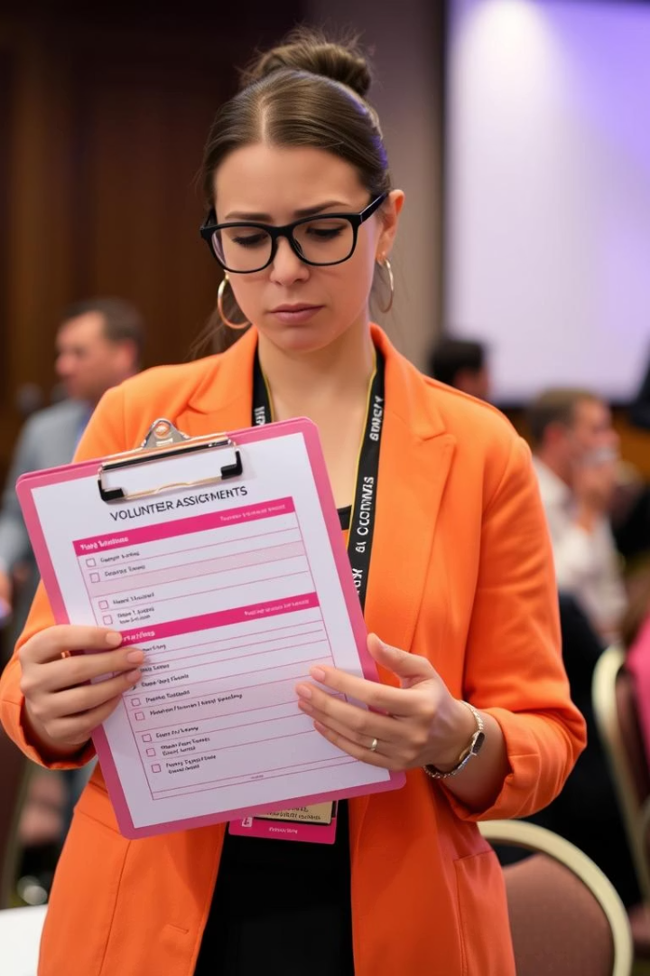



Problem Overview
Event Management Challenge
Resource Optimization
Events require strategic volunteer assignment based on experience and availability
Efficiently matching the right volunteers to appropriate roles
Priority-Based Assignment
Need for a system that can dynamically prioritize volunteers

Slide 4






Project Objectives
Optimize Volunteer Assignment
Create an efficient system for event staffing
Implement Priority Queue
Using Binary Max-Heap data structure
Balance Experience & Availability
60% weight on experience, 40% on availability
Our primary goal is to develop a system that can efficiently assign volunteers to events based on their qualifications. By implementing a priority queue using a binary max-heap, we can ensure that volunteers with the highest combined score of experience and availability are assigned first, optimizing event operations.

Slide 5

Volunteer Class Architecture
Attributes
Methods
Priority Calculation
name: Volunteer's name
__init__: Initialize with name, experience, availability
60% weight on experience years
experience_years: Years of volunteering
40% weight on availability score
__lt__: Compare volunteers based on priority
Higher priority = earlier assignment
availability_score: Score from 1-10
priority: Calculated composite score
__str__: String representation for display

Slide 6



Priority Queue Implementation
Data Structure
List-based max-heap with 1-based indexing
Core Operations
Enqueue, dequeue, peek with O(log n) complexity
Helper Methods
Parent, child indexing, heapify operations
Our priority queue implementation uses a binary max-heap to ensure that volunteers with the highest priority are always at the top of the queue. The implementation includes essential operations like enqueue and dequeue with logarithmic time complexity, making it efficient even for large numbers of volunteers.

Slide 7
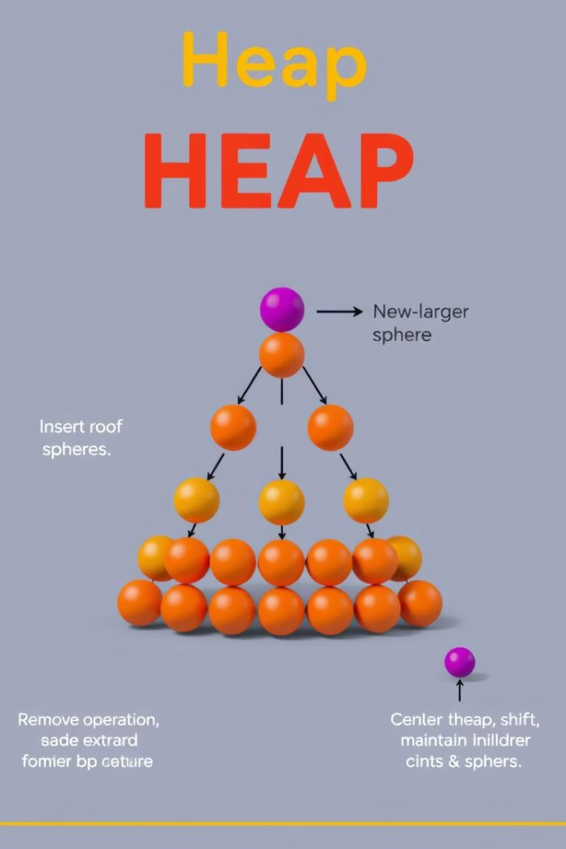




Heap Operations
Enqueue (Insert)
Add volunteer to end of heap, then heapify up to maintain max-heap property
Dequeue (Extract Max)
Remove highest priority volunteer, replace with last element, then heapify down
Peek
View highest priority volunteer without removal (constant time operation)
Heapify
Restore heap property after insertion or removal operations

Slide 8





User Input Functionality
Volunteer Name
Enter volunteer's name (empty name to stop input)
Experience Years
Enter non-negative number with validation
Availability Score
Enter score between 1-10 with validation
Confirmation
Display added volunteer with calculated priority

Slide 9

Sample Execution
Volunteer
Experience
Availability
Priority
Vishnu
8.0
9.0
8.40
Satish
5.0
9.0
6.60
Naveen
4.0
6.0
4.80
Nokesh
2.0
7.0
4.00
Sagar
2.0
4.0
2.80
In this sample execution, five volunteers were added to the system with varying levels of experience and availability. The priority was calculated using our weighted formula (60% experience + 40% availability). The system then assigned volunteers in order of priority, with Vishnu being assigned first due to having the highest priority score of 8.40.

Slide 10







Assignment Process
Input Collection
Priority Calculation
Gather volunteer details with validation
Compute weighted scores
4
Assignment
Queue Management
Dequeue in priority order
Maintain max-heap structure

Slide 11
Key Takeaways & Future Enhancements
Achievements
Future Enhancements
Successfully implemented priority queue using binary max-heap
Add skill-based matching for specific event roles
Implement persistent storage for volunteer database
Created weighted priority system balancing experience and availability
Create graphical user interface for easier interaction
Add reporting and analytics features for event planners
Developed user-friendly input system with validation
Achieved O(log n) time complexity for key operations

Slide 12
REFERENCES
Cormen, T. H., Leiserson, C. E., Rivest, R. L., & Stein, C. (2009). Introduction to algorithms (3rd ed.). MIT Press. Binary heap and priority queue concepts for Priority Queue class.
Goodrich, M. T., Tamassia, R., & Goldwasser, M. H. (2013). Data structures and algorithms in Python. Wiley. Heap-based priority queue implementation in Python.
Python Software Foundation. (n.d.). Python 3 documentation. https://docs.python.org/3/ Python standard library for input validation and formatting.
Project Jupyter. (n.d.). Jupyter Notebook documentation. https://jupyter.org/ Setup and execution of the system in Jupyter Notebook.

Slide 13

THANK YOU

